Slide 1

Weiss High School
March 5 2019

Slide 2

About Me
Shawn Weisfeld
Cloud Solution Architect
Microsoft – One Commercial Partner Technical Team
sweisfel@microsoft.com
Austin, TX
Download Slides @ https://aka.ms/PHS/20181029

Slide 3
About me

Slide 4

Source: http://imgkid.com/snake-game-gif.shtml

Slide 5
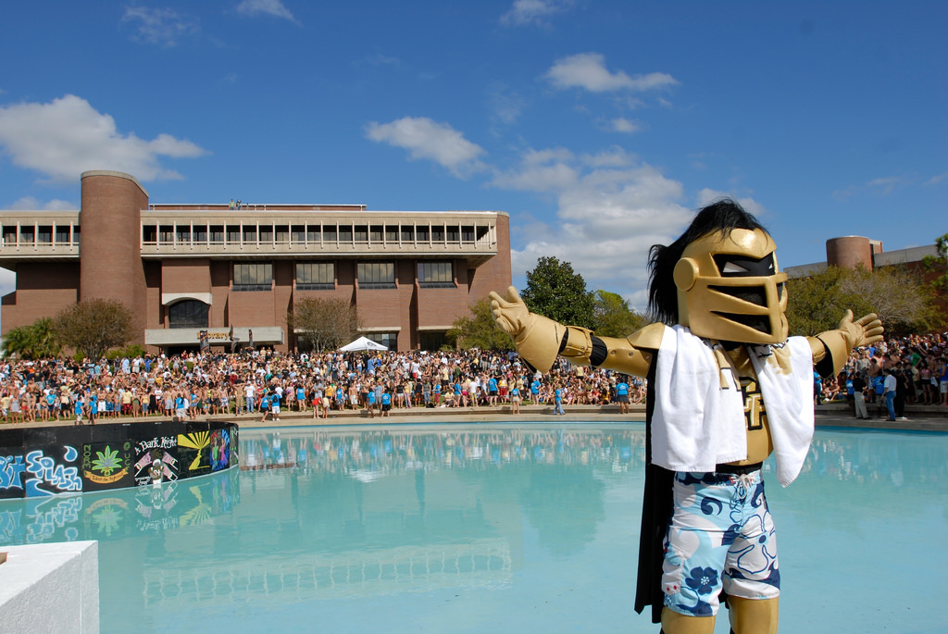

Source: https://www.flickr.com/photos/universityofcentralflorida/3402843642

Slide 6

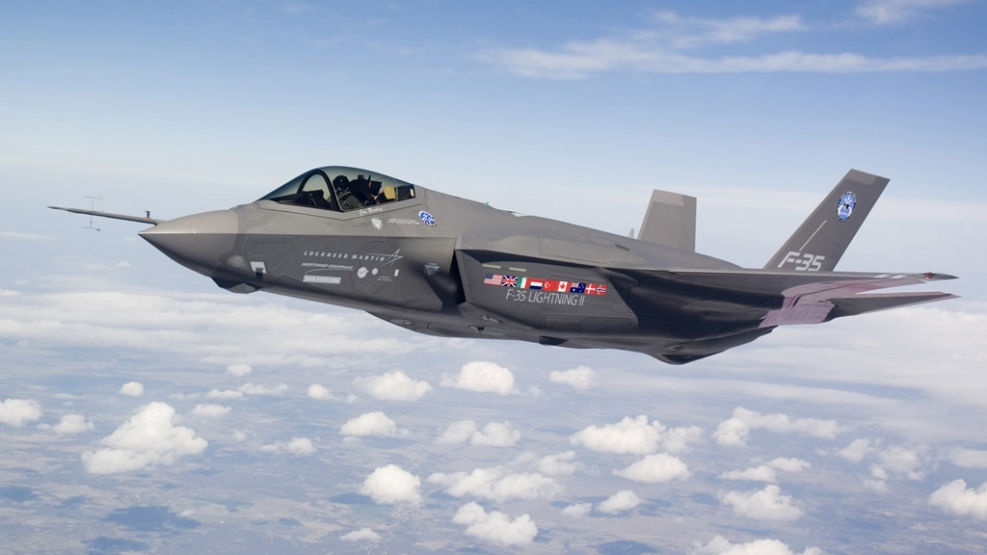
Source: http://www.military-today.com/aircraft/lockheed_martin_f35_images.htm

Slide 7
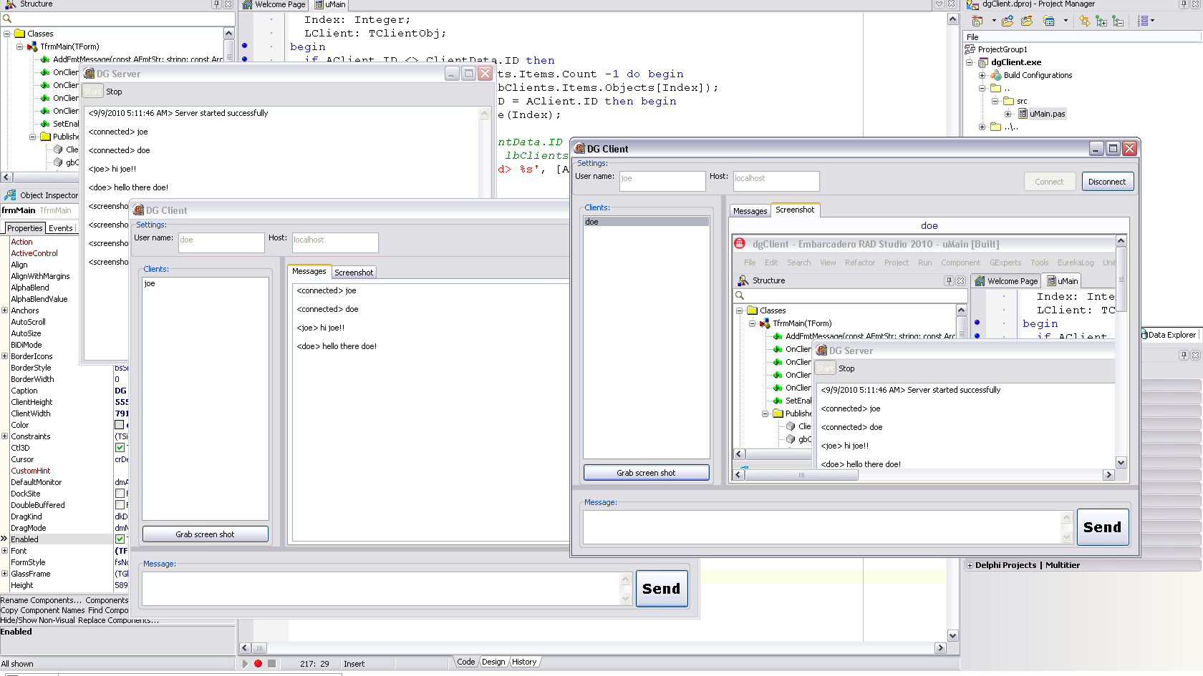
Source: http://www.delphigeist.com/2010/09/custom-client-server-application-with.html

Slide 8
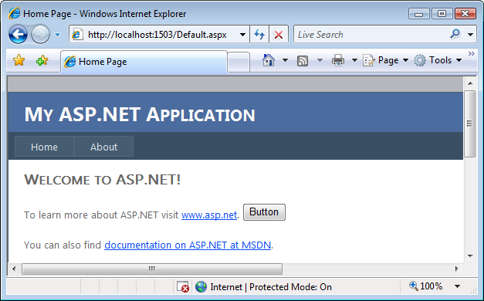
Source: http://dotnetmonitor.vlasovstudio.com/2010/07/06/monitoring-asp-net-applications/

Slide 9


Slide 10
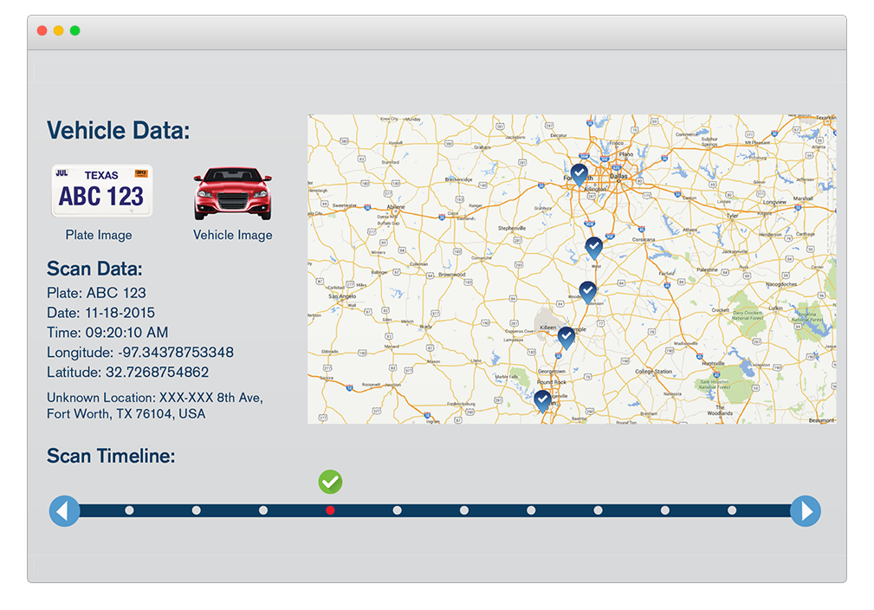
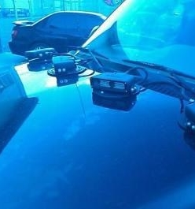

Slide 11


Slide 12

Source: http://cloud9solutions.com/?page_id=19

Slide 13

Source: http://www.passionforsavings.com/weekly-ad/dell-black-friday-ad/9/

Slide 14


Slide 15

Source: https://www.dreamstime.com/royalty-free-stock-photos-cloud-help-text-please-writing-letters-written-clouds-image36840678

Slide 16
What is the cloud?

Slide 17




Slide 18


Slide 19

Source: http://colocation-expert.com/

Slide 20

Source: http://www.businessinsider.com/why-amazon-is-so-hard-to-topple-in-the-cloud-and-where-everybody-else-falls-2015-10

Slide 21
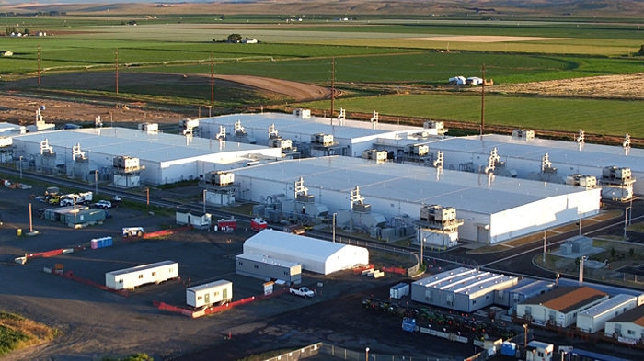
Source: http://images.techhive.com/images/article/2016/12/microsoft-data-center-100697997-large.jpg

Slide 22
Data Center Tour
Interactive
https://cloud-platform-assets.azurewebsites.net/datacenter/
Video
https://www.youtube.com/watch?v=0uRR72b_qvc

Slide 23
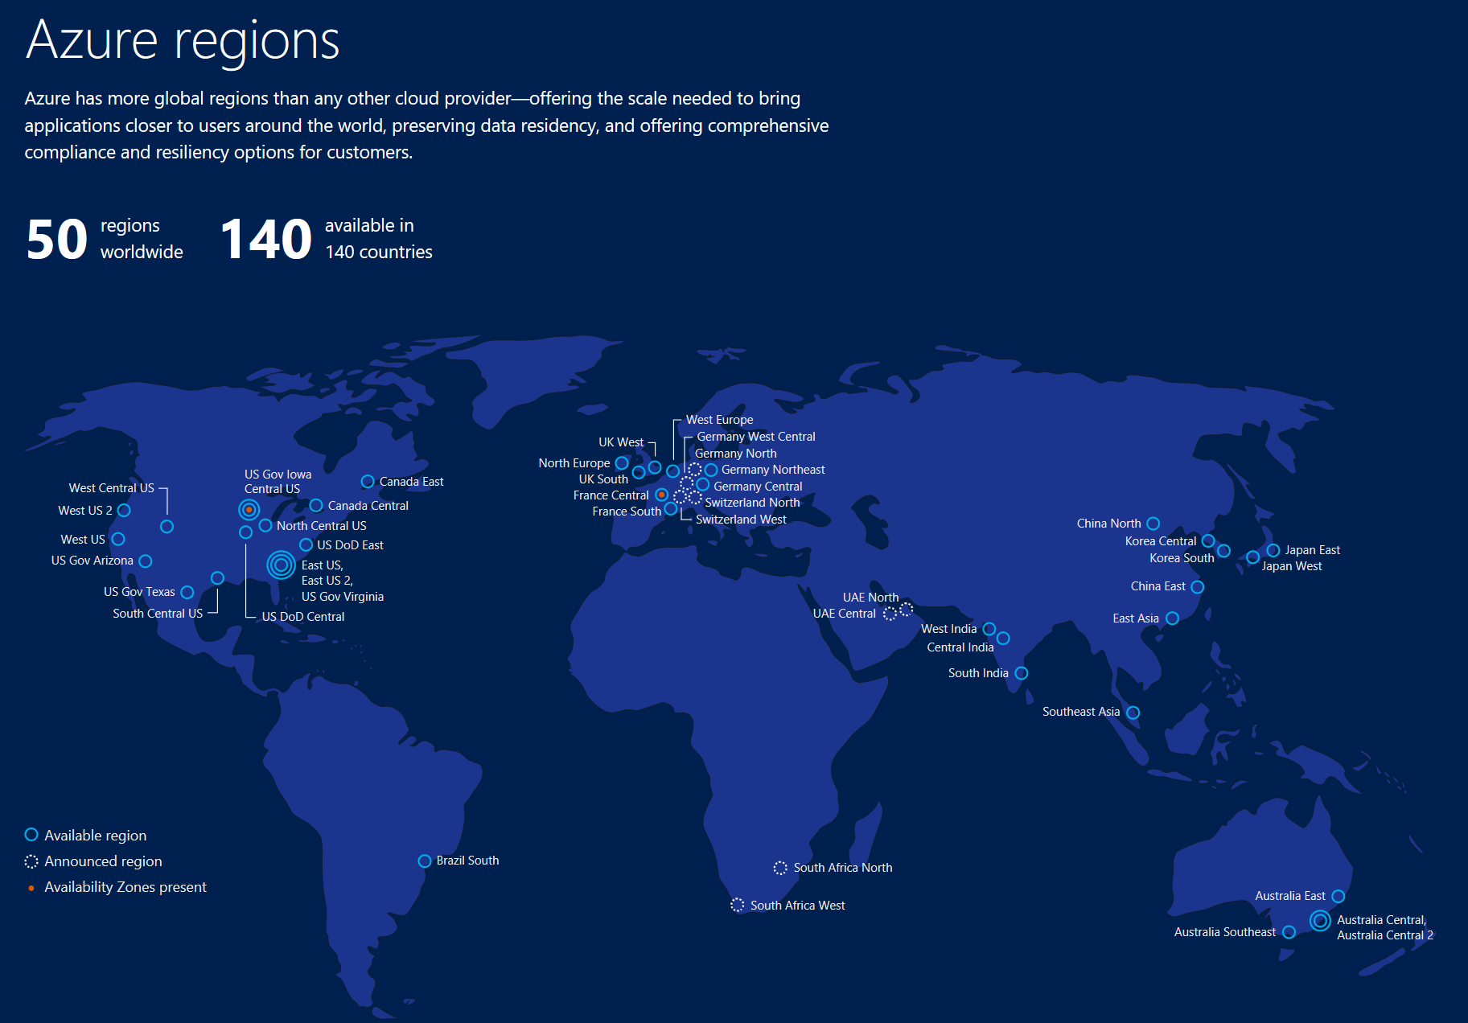

Slide 24
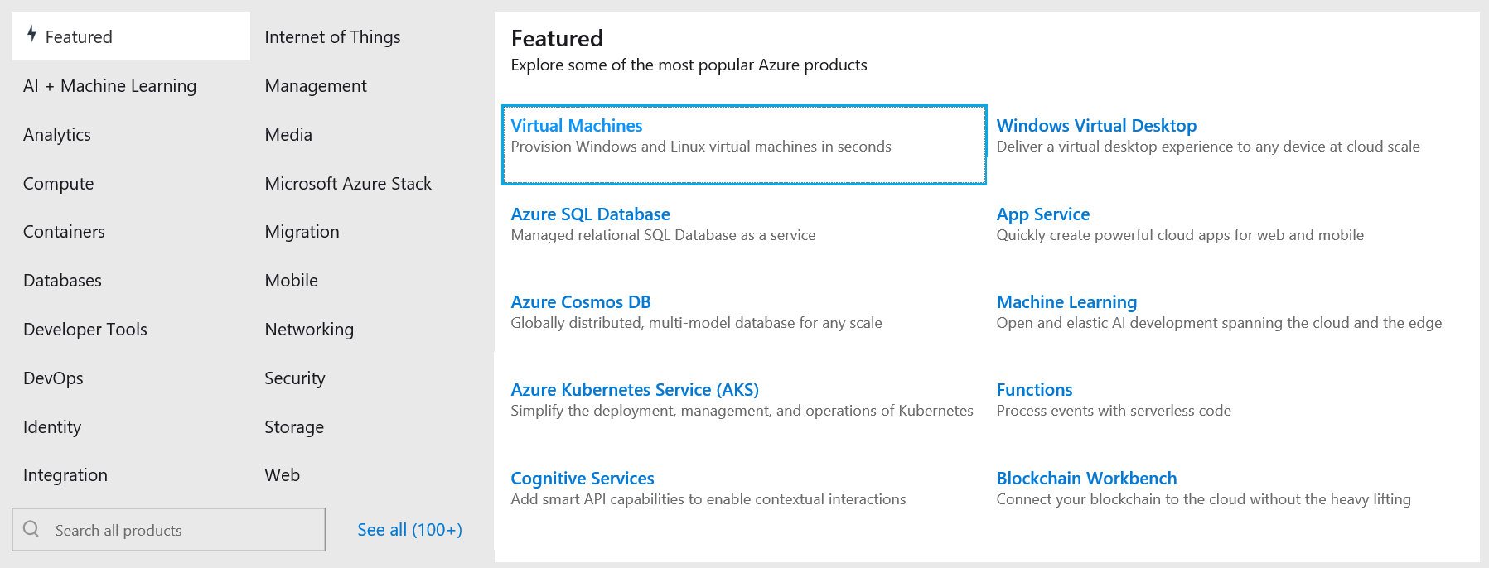
Cloud Services

Slide 25

Microsoft Imagine
https://imagine.microsoft.com
Free Software
Build web, mobile, games, mixed reality
Free Cloud
Host a website & database
Free Training
Imagine Cup Competition
Source: http://www.cloudsprawl.net/beware-of-clouds-bearing-gifts-in-todays-iaas-competitive-landscape/

Slide 26

Artificial Intelligence

Slide 27
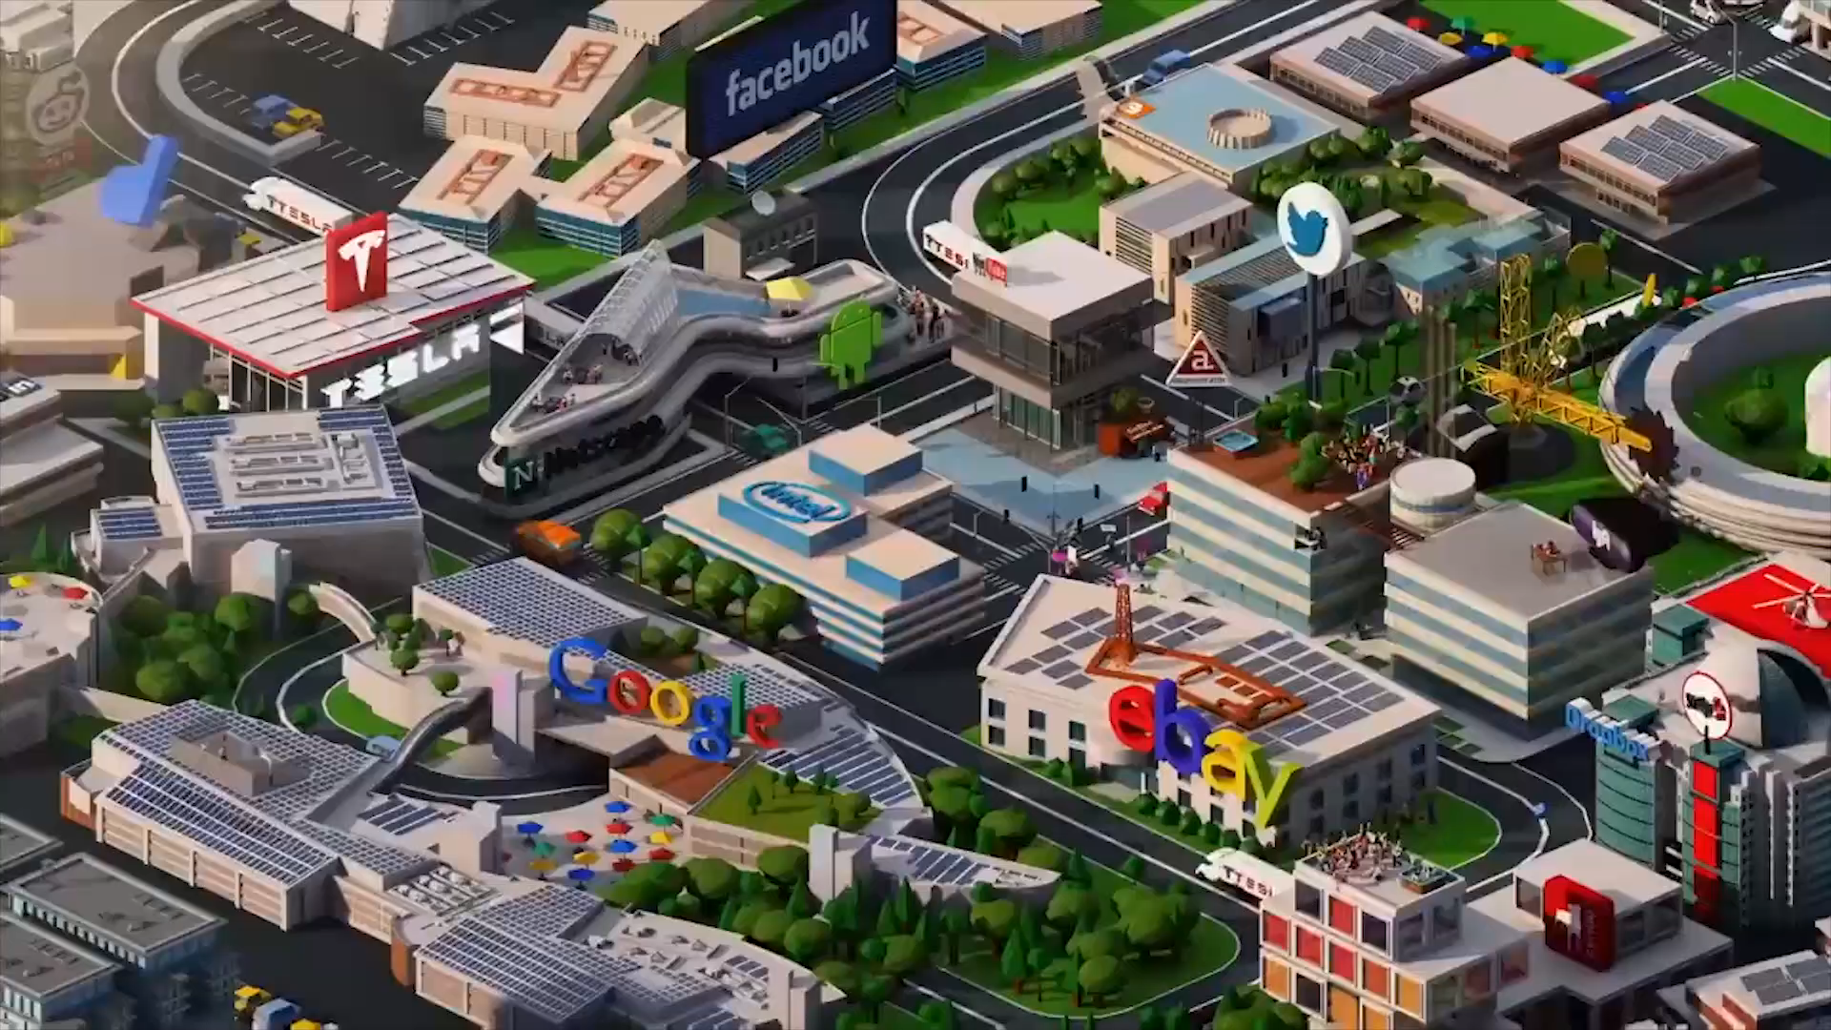
Hot Dog Challenge

Slide 28
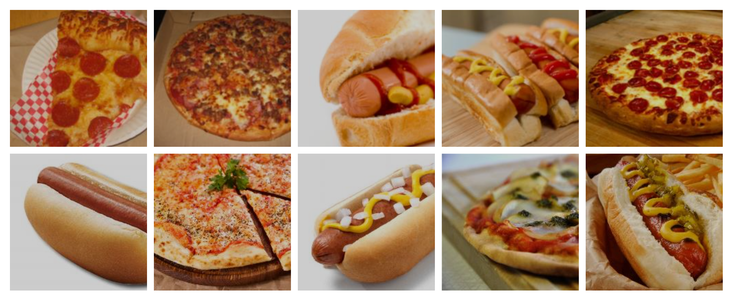
What are these pictures of?

Slide 29

What is Artificial Intelligence
Artificial Intelligence is the theory and development of computer systems able to perform tasks intelligently similar to a human being.
Source: https://www.differencebetween.com/difference-between-machine-learning-and-vs-artificial-intelligence/
https://theaviationist.com/wp-content/uploads/2013/03/Skynet.jpg

Slide 30
How would you code this?

Slide 31
What if we could train the computer?

Slide 32

What is Machine Learning
Machine Learning is a type of Artificial Intelligence that gives the ability for a computer to learn without being explicitly programmed. It uses an algorithm to parse data, learn from it, and make decisions accordingly.
Source: https://www.differencebetween.com/difference-between-machine-learning-and-vs-artificial-intelligence/
https://cdn.redshift.autodesk.com/2016/05/Machine-Learning-hero.jpg

Slide 33
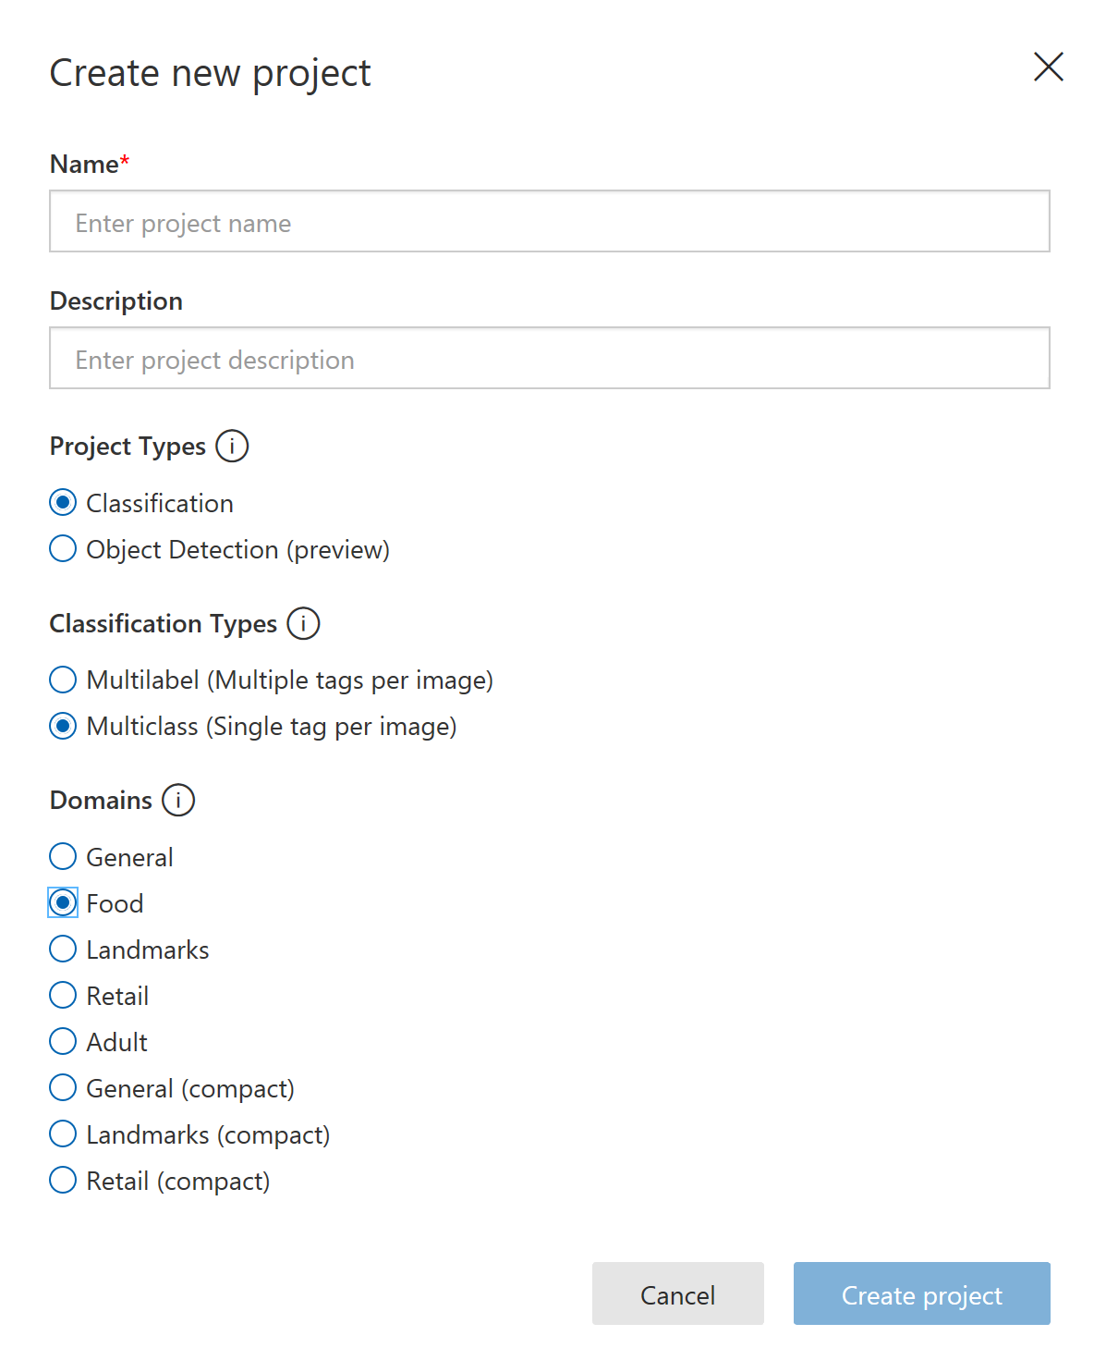
Build it – Create Project
Create a trail account on https://customvision.ai
Create a new project with the following settings

Slide 34
Build it – Show it pictures of hot dogs and pizza
Download 5 pictures of hot dogs from the internet
HINT: you can use image search to find them https://www.bing.com/images
TIP: make sure each is smaller than 4 MB and is a jpg, png or bmp
In your Custom Vision Project Add the images tagging them “hot dog”
Repeat the process with 5 pictures of pizza

Slide 35
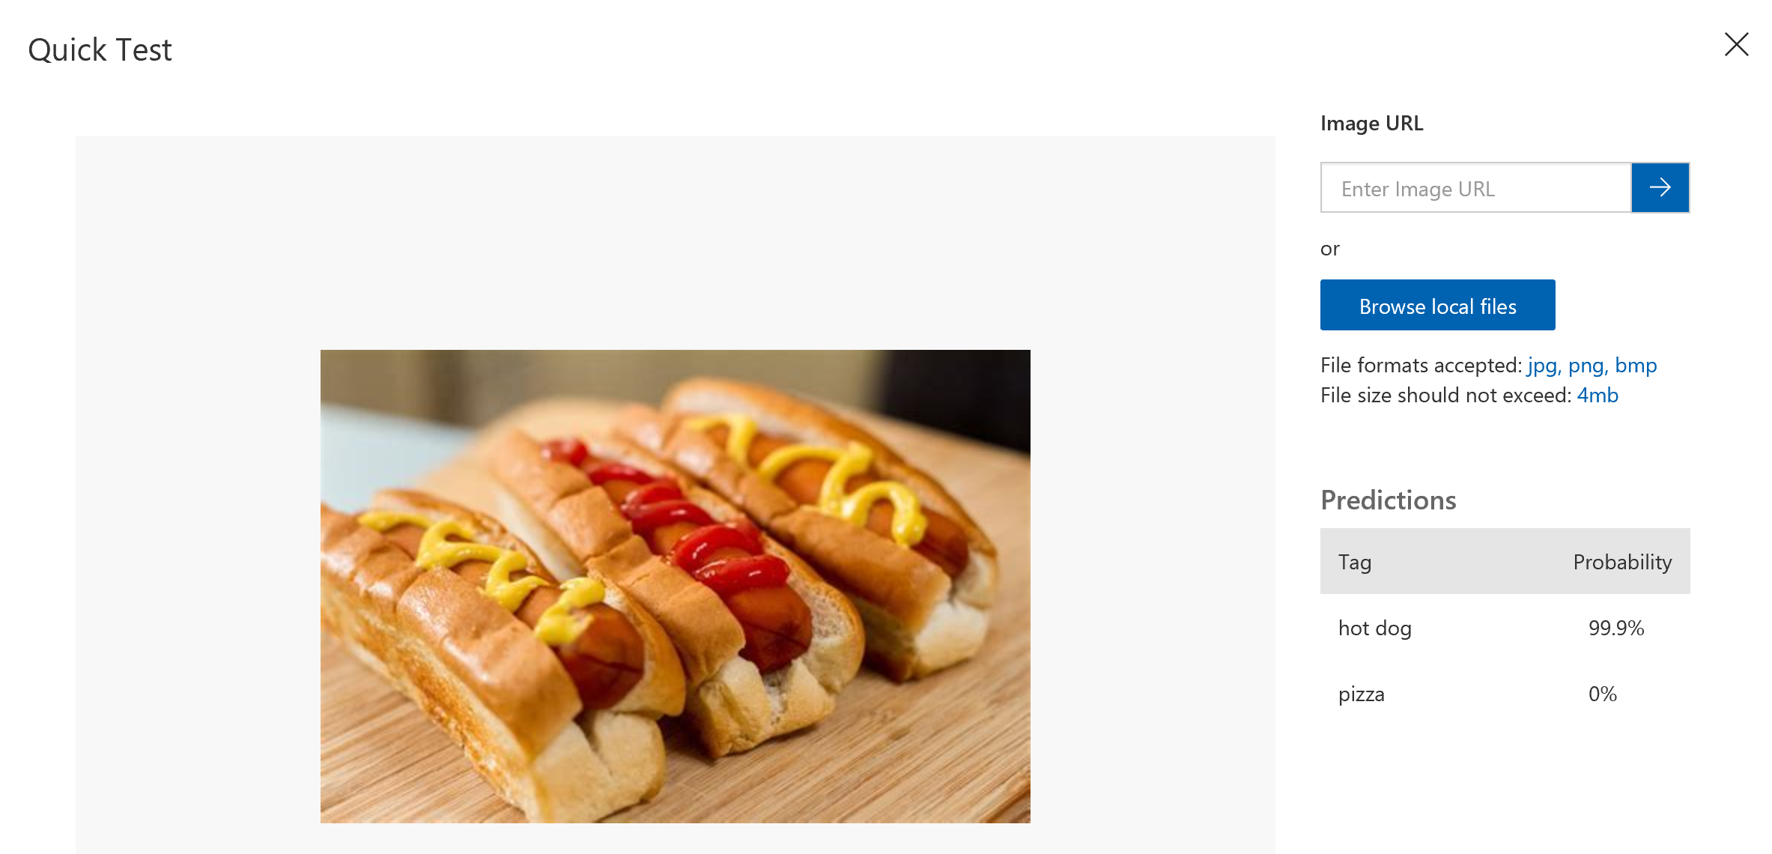
Build it – Train and test your ML Model
Press the green Train button to train the model
Test your model using the “quick test” button

Slide 36
Extend it
Create a new project to do something interesting to you.
Examples:
What Pokémon/cartoon character is it?
What type of sports ball is it?
Brand/Logo detector – Coke, Pepsi, Dr. Pepper?
Sedan or SUV?

Slide 37

Source: http://adjunctassistance.com/teaching-tips-techniques/questions-teaching-tips-techniques/how-college-faculty-should-ask-their-students-questions

Slide 38

Email: sweisfel@microsoft.com
Download Slides @ https://aka.ms/PHS/20181029

